Slide 1
Final Project Ideas
Ryan Keivanfar

Slide 2
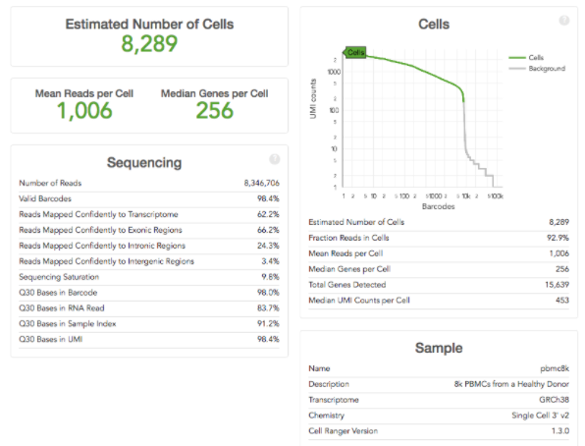
Project Idea 1: Recreate and concatenate data sets + plots
Making scientific assessments from large batches of samples is cumbersome when each sample is represented as its own independent graph

Slide 3
Project Idea 1: Recreate and concatenate data sets
Instead of have x number of individual graphs, where each graph represents a given sample in a batch of samples to be compared, (below)

Slide 4
Project Idea 1: Recreate and concatenate data sets
…the graphs of chosen samples could be overlayed, making data analysis and subsequent experiment planning easier and more efficient

Slide 5
Project Idea 1: Recreate and concatenate data sets + plots
The data:
Datasets are available to download as matrices (.mtx) through my job

Slide 6
Project Idea 2: Map individual sample traces to histogram of population
Individual sample traces of a given biological sample reveals information about the given sample, and a histogram of the population of samples reveals information about the effectiveness of the technology being implemented. The ability to match a given sample’s location on the histogram would be beneficial in assay development.

Slide 7
Project Idea 2: Map individual sample traces to histogram of population
Graphs each represent an individual sample from the histogram, however their location on the histogram is unknown
Histogram is representative of a population of samples
d
b
a
c

Slide 8
Project Idea 2: Map individual sample traces to histogram of population
For purposes of assay development, it would be beneficial to know the corresponding histogram location for each trace
d
b
a
c

Slide 9
Project Idea 2: Map individual sample traces to histogram of population
The data:
Datasets are available to download as BAM (Binary-sequence aligned format) files (.bam) through my job

